Slide 1

Ultimate Tic Tac Toe: Enhancing Strategy and Critical Thinking
Final Project for DSA/CIS 230/492/593
Group Members:
Sravani Mothukuri (2844911)
Michael Hylton (2788154)
Keerthi Gurram (2845652)

Slide 2
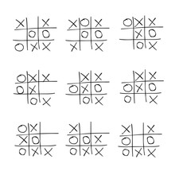
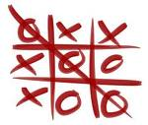
What is Ultimate Tic Tac Toe?
A strategic evolution of the classic Tic Tac Toe game.
Features a 3x3 grid of larger squares, each containing its own 3x3 grid of smaller squares.
The position played in a smaller square dictates the opponent's playable larger square.
Merges tactical precision with big-picture strategic planning.

Slide 3

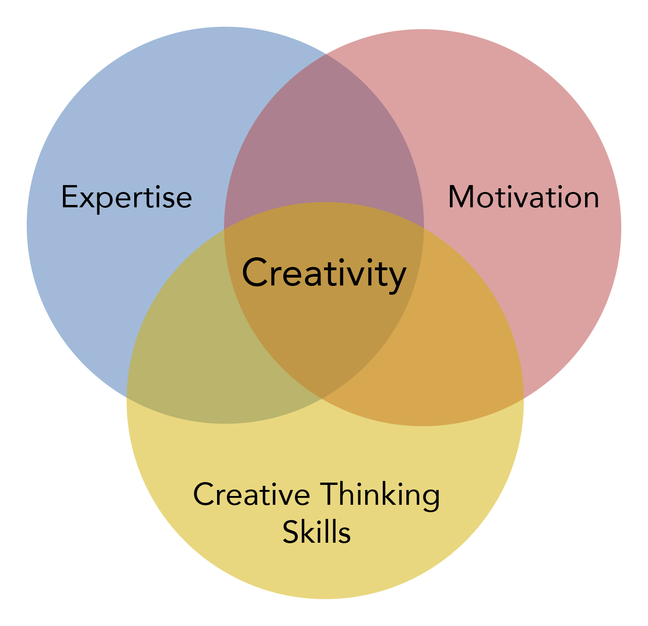
Why This Project?
Encourages critical thinking and strategic planning.
Aligns with personal and professional goals of solving complex challenges.
Enhances creativity, logic, and programming skills.
Offers a unique opportunity to merge fun with learning.

Slide 4
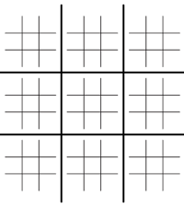
Design Approach
Create a 3 by 3 Matrix of 3 by 3 Matrixes using Numpy. This will be the board.
Create a game loop that alternates between players. Allow each player to make a move and then alternate to the next player.
Check in between each players turn if they won any of the sub boards or won the game.

Slide 5
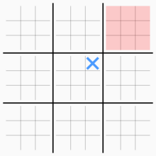
Technical Details
Program different Rules of the game:
Forces a players move to be in the appropriate square, as shown by checking the main row and column
If the next move is in a square that has already been won, allow the player to choose any free space as their next move. This is done by un-setting nextBoard.
If a player gets a three in a row, make the square inaccessible.

Slide 6
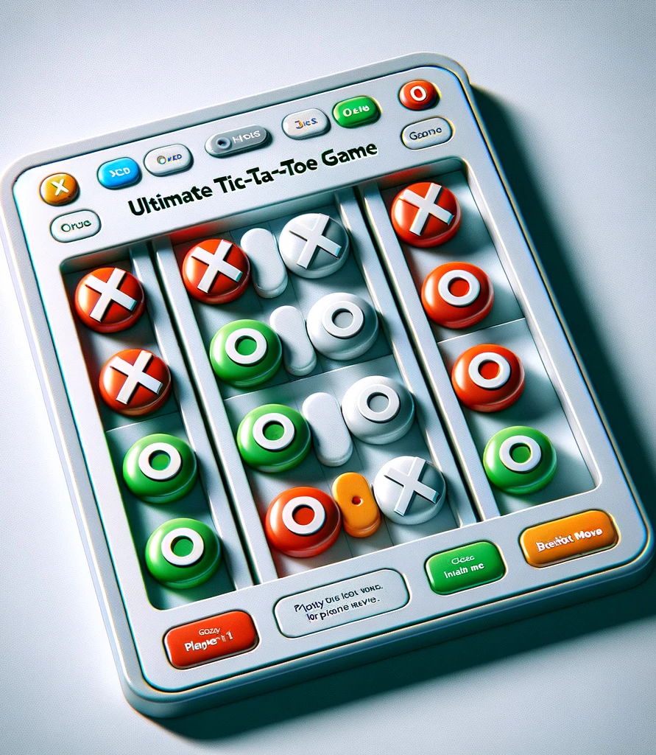
GUI Overview
The GUI implementation for the "Ultimate Tic-Tac-Toe" game is developed using Python's tkinter library. It provides an interactive platform for playing the advanced version of Tic-Tac-Toe.
The interface consists of a 3x3 grid of mini-boards, each of which is itself a 3x3 grid of buttons. These buttons dynamically update with "X" or "O" based on the player's move and are disabled after a move is made to prevent re-selection.
The GameGUI class handles the creation and management of the GUI, integrating with the backend UltTicTacToe class for game logic.

Slide 7
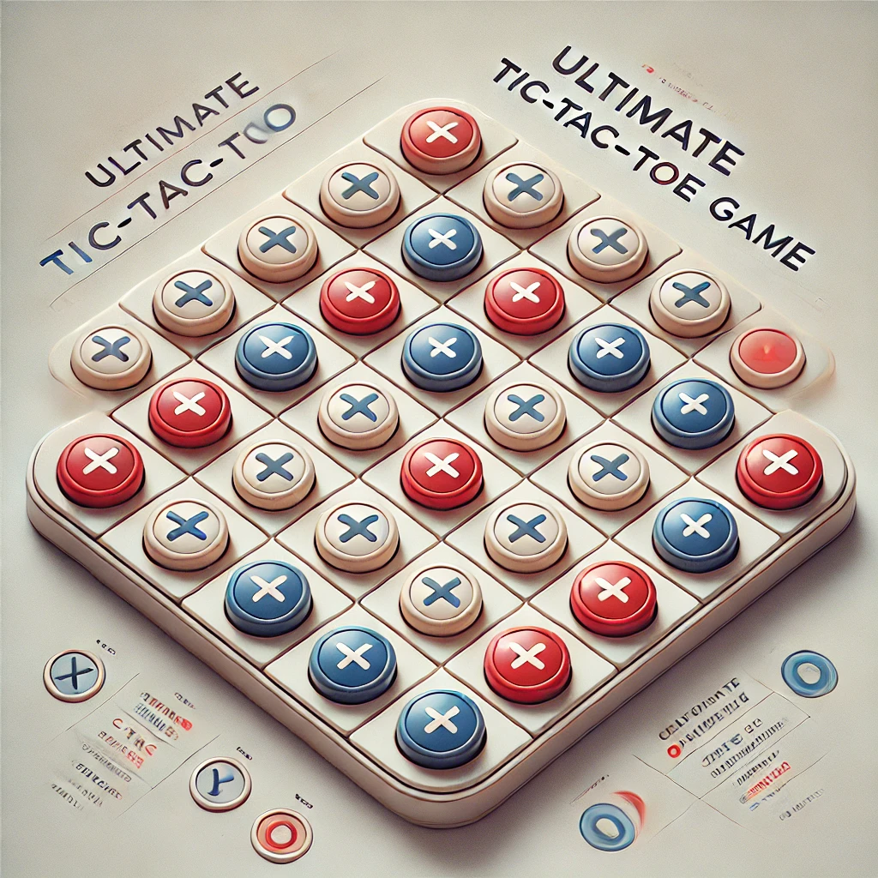
The board is created using nested frames, where each mini-board is a separate frame within the main board. Buttons are stored in a dictionary with their coordinates, enabling easy access and updates. The GUI is visually appealing and functional, with player feedback provided at each step through messages and visual updates. This design makes the game engaging and intuitive, with the potential for further enhancements, such as AI integration for single-player mode or customization options for themes and player names.

Slide 8
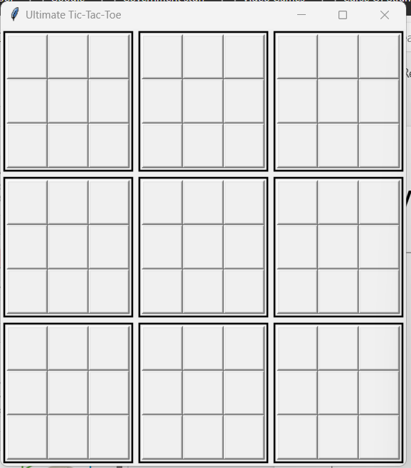
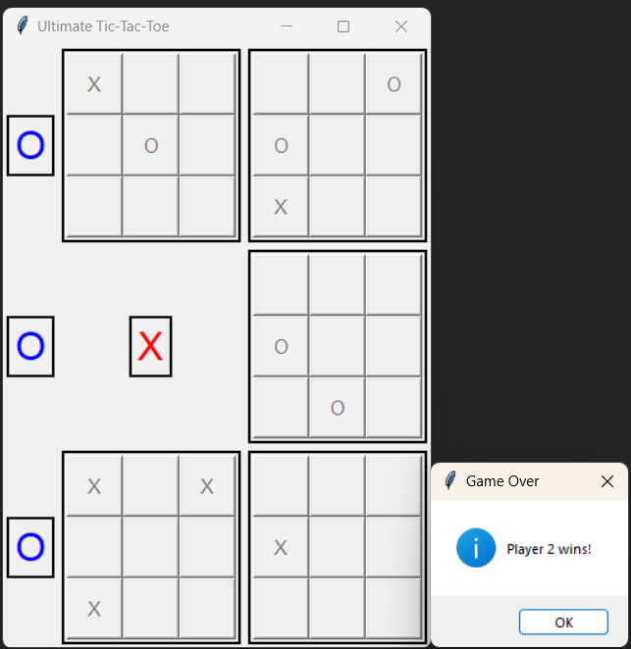
A Live Demo!

Slide 9

Conclusion
Project Summary:
Successfully combined Python programming and GUI design to create a playable and enjoyable game.
Implemented complex rules of Ultimate Tic-Tac-Toe while maintaining simplicity for the user.
Learning Outcomes:
Enhanced understanding of Python’s capabilities, especially NumPy for data structures and Tkinter for GUI.
Improved problem-solving skills through tackling challenges like board state validation and interactive design.
Real-World Relevance:
Demonstrated how software development can be applied to create engaging applications.
Showed how coding principles like modularity, error handling, and user interface design are integral to real-world projects

Slide 10
References
Comprehensive guide for building graphical user interfaces in Python
https://docs.python.org/3/library/tk.html
Resources explaining the rules and strategies of Ultimate Tic-Tac-Toe.
https://mathwithbaddrawings.com/ultimate-tic-tac-toe/

Slide 11
Thank you

